Slide 1
Introduction
Project Overview
Introduction to the project and its importance
Brief explanation of the entertainment industry's role in society

Slide 2

Entertainer Data Analytics
Domain:
Film and Entertainment
Objective:
To analyze and derive insights from data related to the film and entertainment industry to understand trends, audience preferences, and other key metrics.

Slide 3

Entertainment industry's role in society
The entertainment industry is a vibrant escape from daily life, offering a blend of relaxation and adventure through movies, music, and shows.
It shapes cultural trends and brings people together, from blockbuster films to viral songs.
Beyond its role in our leisure, it is a dynamic force that enriches our lives and connects us all.

Slide 4
Technologies
- Data Science
- Python
- Tableau

Slide 5

The need for entertainment to reduce stress
Entertainment is crucial for reducing stress because it provides a mental break from everyday pressures.
Engaging in activities like watching movies, listening to music allows people to temporarily escape their worries, unwind, and shift their focus.
This relaxation helps lower stress levels, improves mood, and enhances overall well-being by offering a form of self-care and enjoyment.

Slide 6

Importance of analyzing entertainment data
Analyzing entertainment data uncovers trends and preferences, helping creators and businesses tailor content to audience tastes.
It drives smarter decisions, boosts engagement, and reveals what captivates viewers or listeners, turning insights into hit shows, songs, and movies.
In essence, it transforms raw numbers into entertainment magic!

Slide 7
Approaches and Tools
- Python
- Tableau

Slide 8
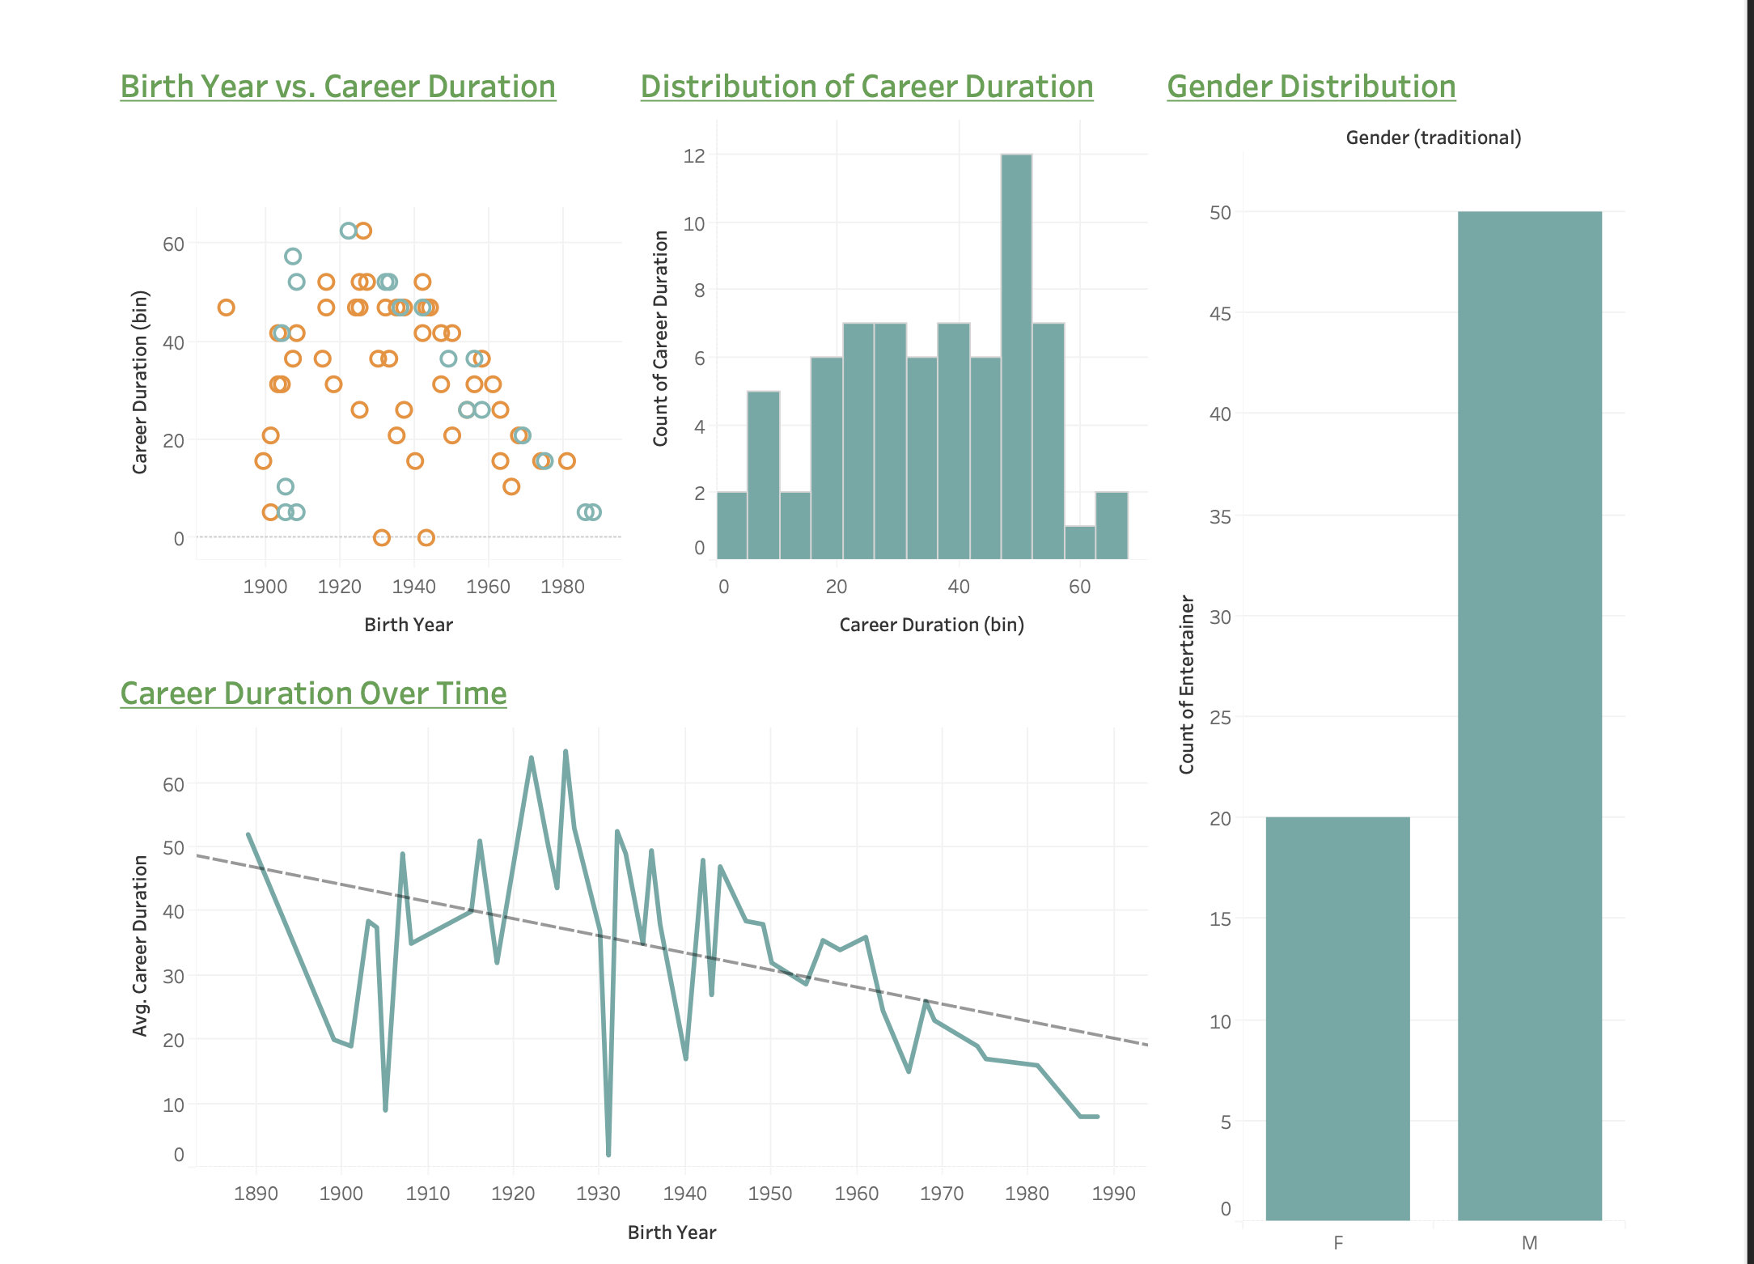
My Dashboard

